Slide 1
Minnesota Technology Association
Board of Directors
Meeting
December 10, 2021
Virtual Meeting via Zoom

Slide 2
Agenda
Call to Order / Roll Call 8:30 – 8:45
Approval of October Meeting Minutes 8:45 – 8:50
Financial Report 8:50 – 9:00
CEO Report 9:00 – 9:30
Legislative Update 9:30 – 9:40
Election of Directors & Officers 9:40 – 10:00
Other Business/General Discussion 10:00 – 10:30

Slide 3
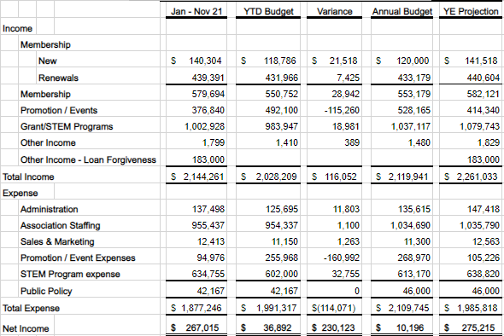
2021 YTD
Income Statement

Slide 4
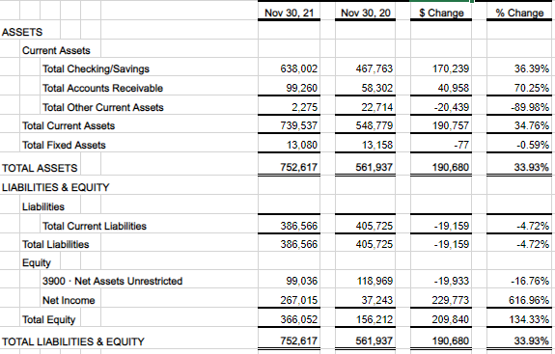
11/30/2021
Balance Sheet

Slide 5
CEO Report
Headlines
Welcoming 4 new team members
Exceeding plan on new & renewing memberships
42 virtual events to date with 5,292 attendees
SciTech/MN SBIR both impactful & self-sufficient
Tech Inclusion Alliance top priority for 2022

Slide 6
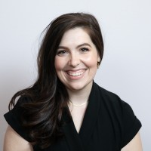
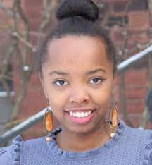
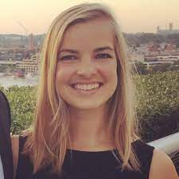
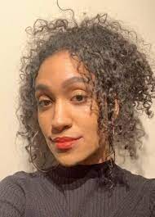
Welcome to MNTech!
Leah Patton
VP, Programming
Caroline Karanja
Director, TIA
Katie McClelland
Director, Policy & Research
Yahsmene Butler
Engagement Manager, TIA

Slide 7
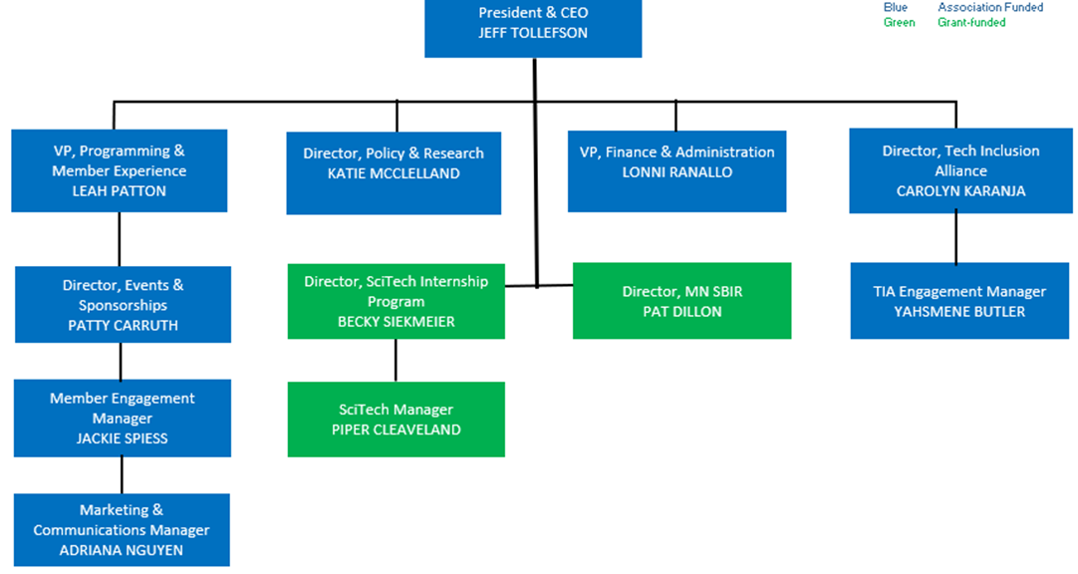
2022 Organizational Chart

Slide 8
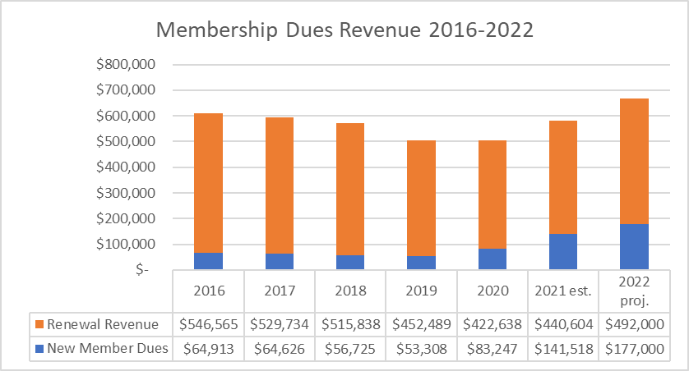
Membership Trending Up!

Slide 9

New Members
42 new member companies in 2021
12 large organizations with $10k+ memberships, including 3M, Abbott, Ameriprise, Cargill, Entegris, Horizontal, Jamf, Pearson VUE, Polaris, Starkey, Surescripts, and U.S. Bank
Ready to launch next round of new member outreach in January
Identified 37 target prospects representing $339k of estimated annual revenue

Slide 10



Programming
Tekne Awards drew 411 attendees to November 17th virtual celebration
5,292 attendees at 42 events
Event sponsorships now available for 2022

Slide 11
Event Income

Slide 12
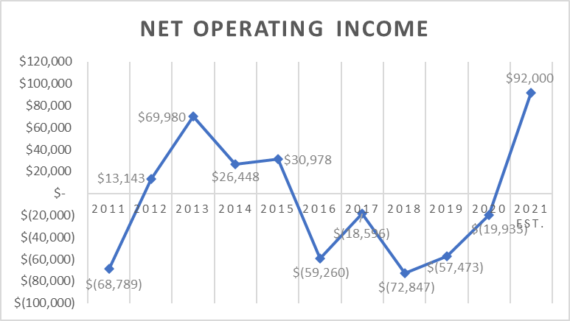
2021 Marks our Return to Profitability

Slide 13
Tech Inclusion Alliance Overview
CIO-led coalition of large tech employers working to nurture and expand a diverse pool of local technology talent
Collaborative effort to share best practices, co-create mutually beneficial solutions, and leverage collective influence/budgets to drive community impact
Currently working with alliance and community members to establish objectives, ideate strategies, and define key results
While CIO-led, MnTech serves as backbone organization convening members and implementing work of Alliance

Slide 14
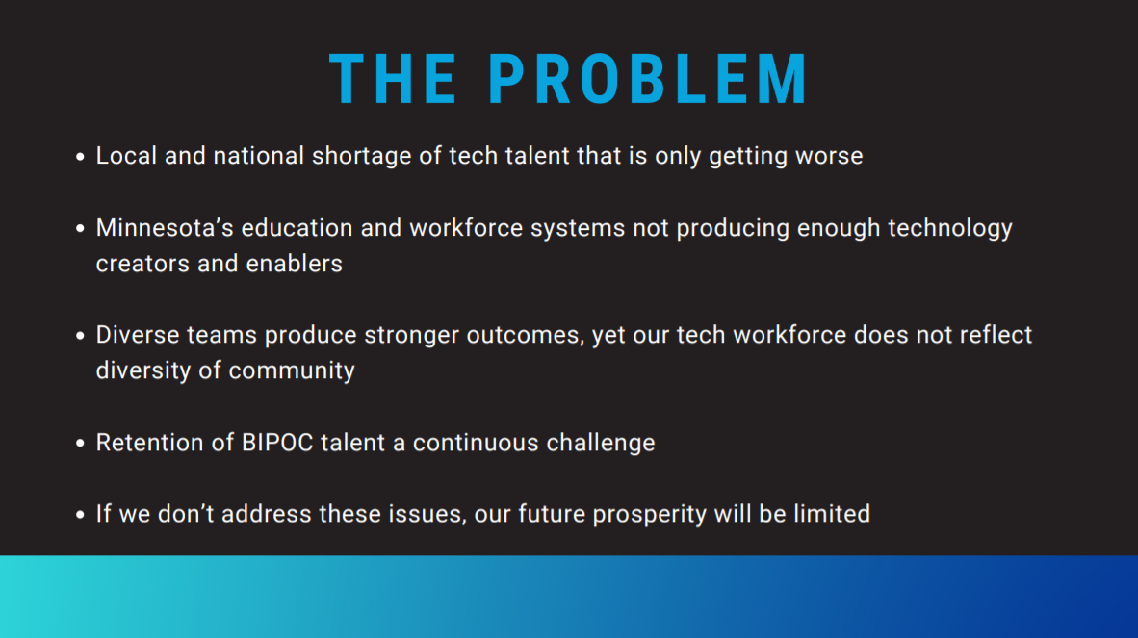

Slide 15
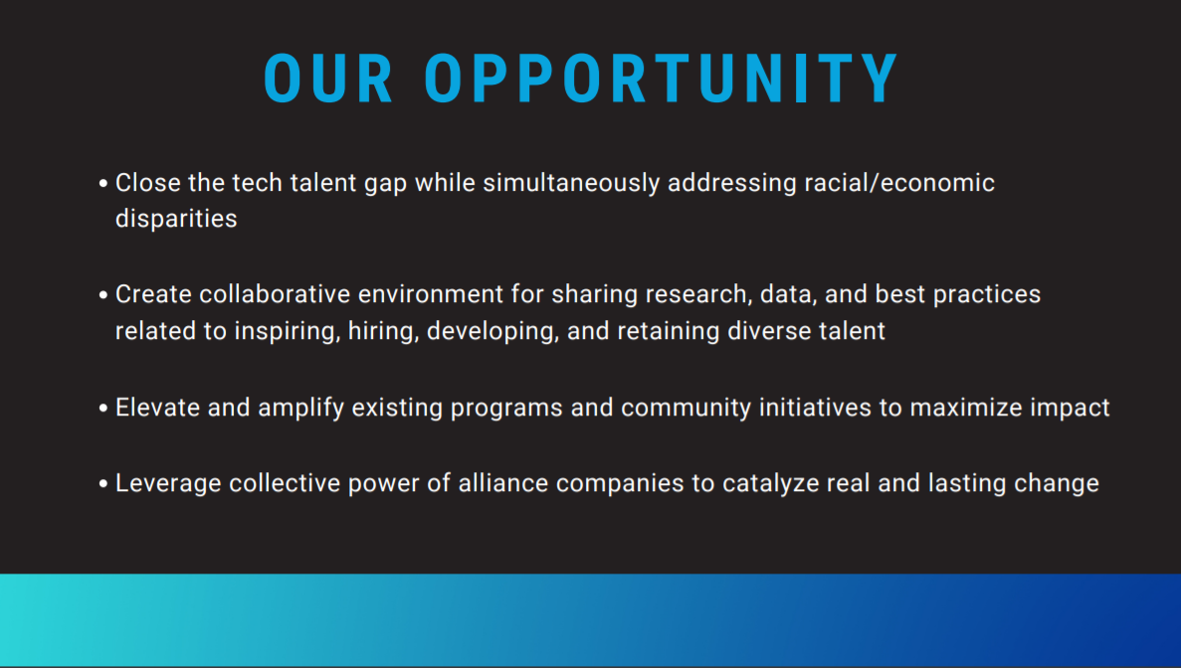

Slide 16
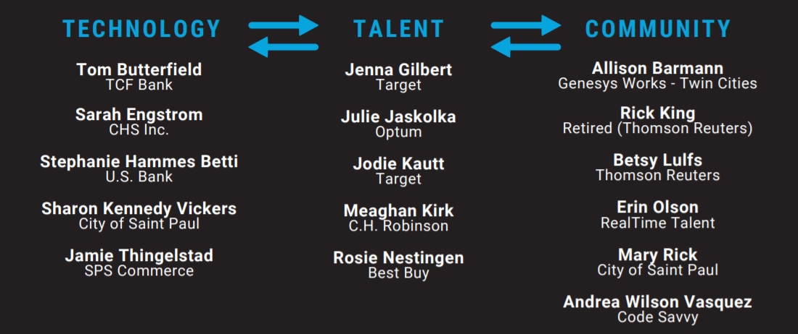
TIA Working Group (10/1 – 11/7)

Slide 17
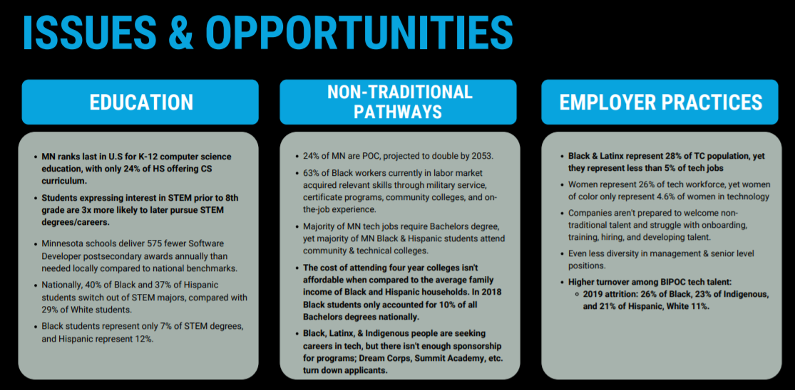

Slide 18


Slide 19
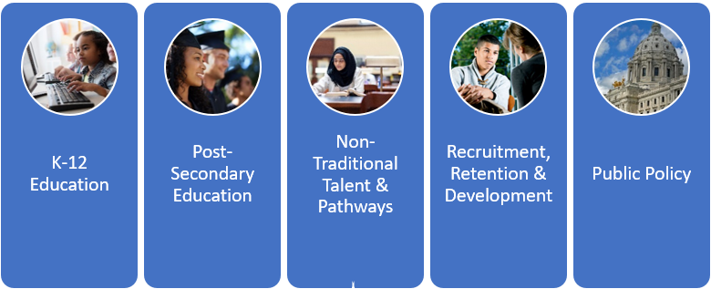
Focusing on Five Primary Workstreams

Slide 20

TIA Status and Next Steps
Caroline getting up-to-speed, charting new path forward
Currently recruiting for workstream steering teams, scheduling January kick-off meetings
Developing TIA organizational capacity, communication tools, web site, etc.
Next TIA CIO meeting tentatively scheduled for morning of February 23

Slide 21
Board Governance
Elect New Board Members
Elect New Officers

Slide 22
Board of Directors Elections
Board Member Re-Elections:
  Ed Foppe, PwC
  Chuck Lefebvre, Unisys
  Cy Morton, Robins Kaplan
  Matt Reck, HelpSystems
  Vinny Silva, Accenture
  Paul Weirtz, AT&T

Slide 23
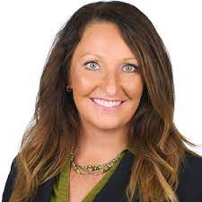
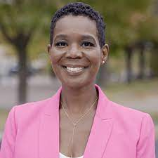
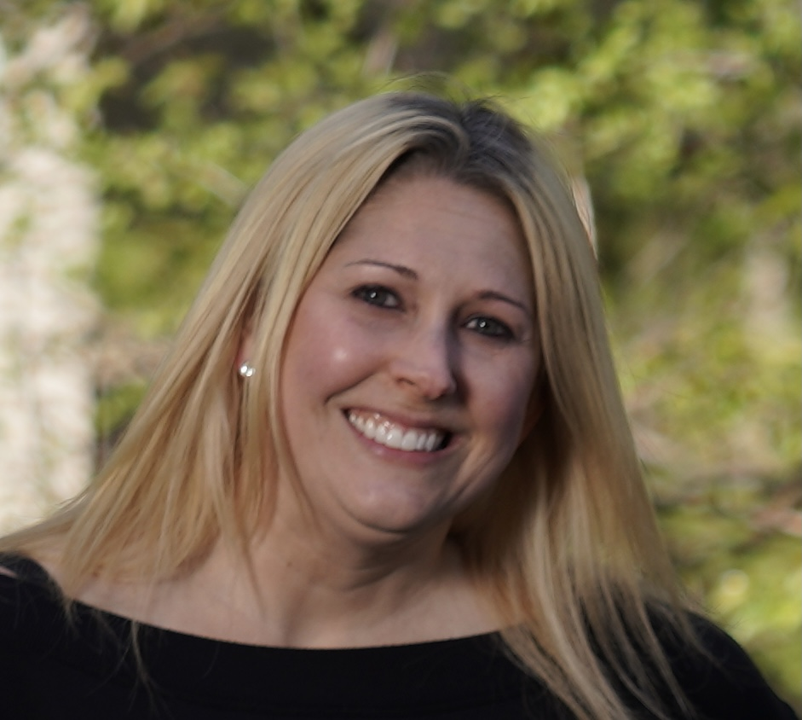
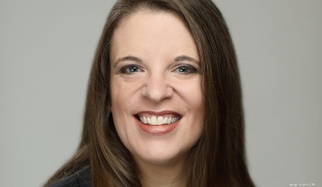
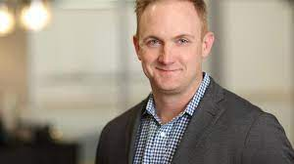
Election of New Board Members
Robin Brown
CIO – Protein, Cargill
Sharon Kennedy Vickers
CIO, City of Saint Paul
Sarah Segar
Sr. Director, Best Buy
Rachel Lockett
CIO, Pohlad Companies
Josh Jabs
CTO, Calabrio

Slide 24
Board Officer Elections
Proposed 2022 Board Officers:
  Chairperson – Cy Morton
  Vice Chair – Sri Koneru
  Treasurer – Ed Foppe
  Secretary – Doug Carnival

Slide 25
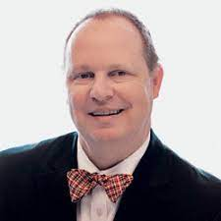
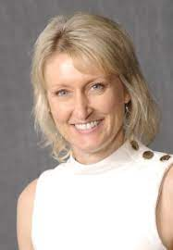
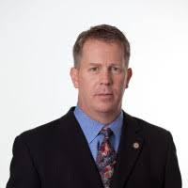
Many Thanks to Our Directors Emeritus!
Todd Hauschildt
17 years of service
Jacquelyn Crowhurst
11 years of service
Scott Singer
11 years of service

Slide 26

Other Business / General Discussion
26

